Slide 1
CCW LAWS AND SAFETY
Lake County Assistant Prosecutor Michael DeLeone
Corporal Robert Harps
Deputy Christopher Cichon

Slide 2
In 2004, House Bill 12, known as Concealed Carry passed and went into law.

Slide 3
2018 annual CCW Statistics
LAKE COUNTY 2018 STATS
New licenses issued- 4,403
Licenses renewed- 4,179
Licenses suspended- 111
Licenses revoked- 1,380
Licenses denied- 90
Lake County ranked 2nd in the State of Ohio for the issuance of the most CCW permits in all of 2018.
2018 STATE OF OHIO
New licenses issued- 69,375
Licenses renewed- 98,927
Licenses suspended- 1,738
Licenses revoked- 1,879
Licenses denied- 1,436

Slide 4
Concealed Carry Sign
The concealed carry sign can be found at the Ohio Attorney General’s Website by following the link:
https://www.ohioattorneygeneral.gov/Files/Publications-Files/Publications-for-Law-Enforcement/Concealed-Carry-Publications/Model-Concealed-Carry-Sign.aspx

Slide 5
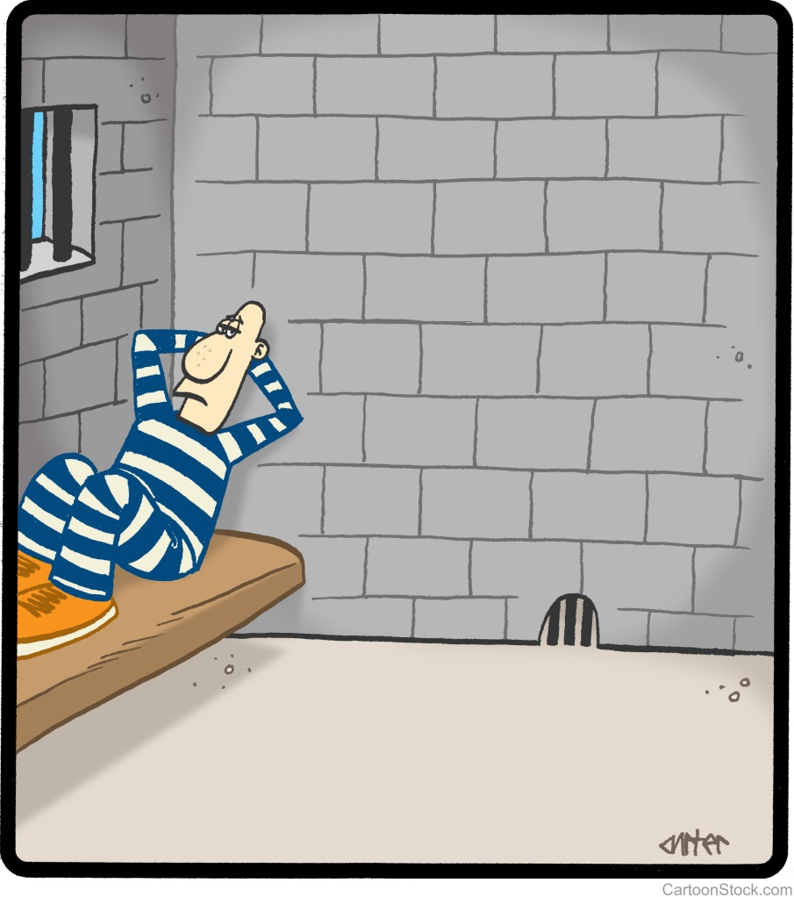
Duties of licensed individual orc 2923.126
A person who knowingly violates a posted prohibition is guilty of criminal trespass in violation of Section 2911.211(A)(4) of the Revised Code and is guilty of a fourth degree misdemeanor.
A fourth degree misdemeanor is punishable with up to 30 days in jail, a fine up to $250.00, or a combination of both.

Slide 6
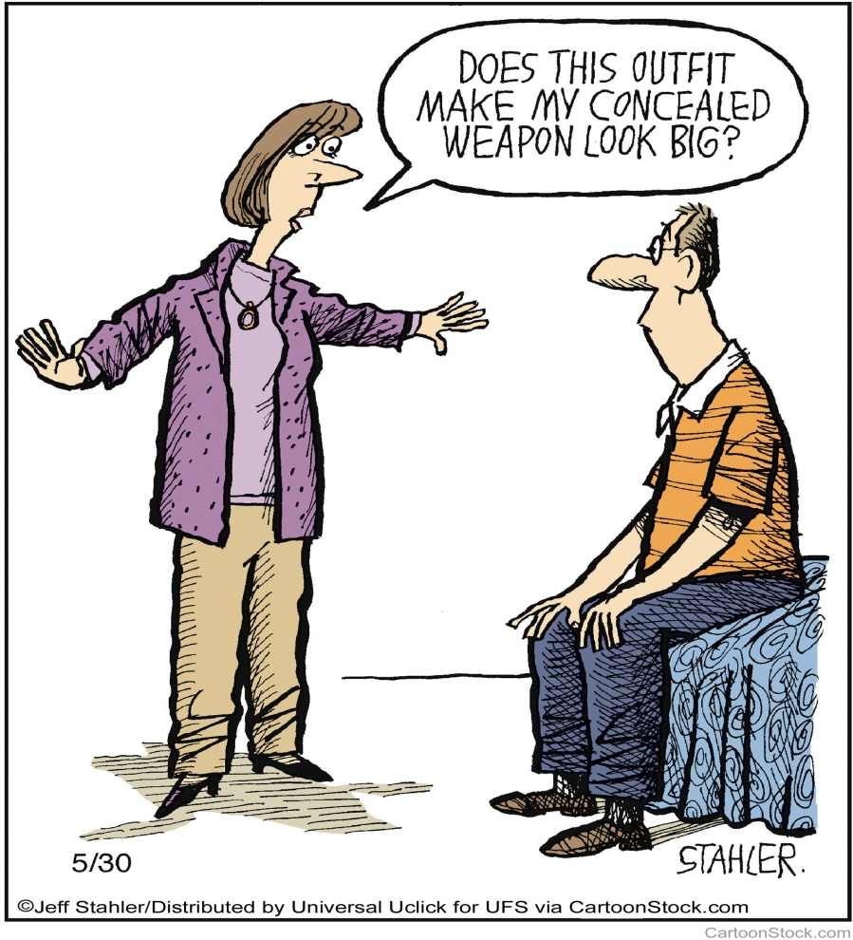
Places prohibited to carry concealed
Police station
Sheriff's office
State highway patrol station
Premises controlled by the Bureau of Criminal Identification and Investigation
A state correctional institution, jail, workhouse, or other detention facility
Any area of an airport passenger terminal that is beyond a passenger or property screening checkpoint or to which access is restricted through security measures by the airport authority or a public agency;
A mental health institution

Slide 7
A school safety zone
A courthouse or another building or structure in which a courtroom is located
Any premises or open air arena that serves alcohol while consuming alcohol
Any public or private college, university, or other institution of higher education, unless the handgun is in a locked motor vehicle or the licensee is in the immediate process of placing the handgun in a locked motor vehicle or unless the licensee is carrying the concealed handgun pursuant to a written policy, rule, or other authorization that is adopted by the institution's board of trustees or other governing body

Slide 8
Any church, synagogue, mosque, or other place of worship, unless the church, synagogue, mosque, or other place of worship posts or permits otherwise
Any government building unless the governing body with authority over the building has enacted a statute, ordinance, or policy that permits a licensee to carry a concealed handgun into the building
A place in which federal law prohibits the carrying of handguns

Slide 9
Concealed carry in the workplace
A private employer shall be immune from liability in a civil action for any injury, death, or loss to person or property that allegedly was caused by or related to a licensee bringing a handgun onto the premises or property of the private employer, including motor vehicles owned by the private employer, unless the private employer acted with malicious purpose.
A private employer is immune from liability in a civil action for any injury, death, or loss to person or property that allegedly was caused by or related to the private employer's decision to permit a licensee to bring, or prohibit a licensee from bringing, a handgun onto the premises or property of the private employer.
See RC 2923.126(C)(2)(a)

Slide 10
EMPLOYEES RIGHTS ORC 2923.1210
Under Ohio’s new law, employees who have a valid concealed handgun license (CCW) may possess firearms in their privately owned motor vehicles under the following conditions:
When absent from the vehicle, the firearm and ammunition must be locked in the trunk, glove box or other enclosed compartment of the vehicle.
When the license holder is present in the vehicle, the firearm and ammunition must remain in the vehicle.
The license holder’s vehicle must be parked in a permitted location.

Slide 11
EMPLOYER RIGHTS ORC 2923.1210
Employers still maintain the following rights:
Prohibit firearms that do not comply with the above requirements.
Prohibit employees from bringing firearms inside company premises or from carrying them outside of their vehicle while on company premises.
Prohibit employees from transporting and storing firearms in a company vehicle.
If the employee does not have a fixed jobsite, the employer may not prohibit an employee from transporting or storing a firearm or ammunition, except where it is illegal to possess a concealed firearm such as a police station.

Slide 12
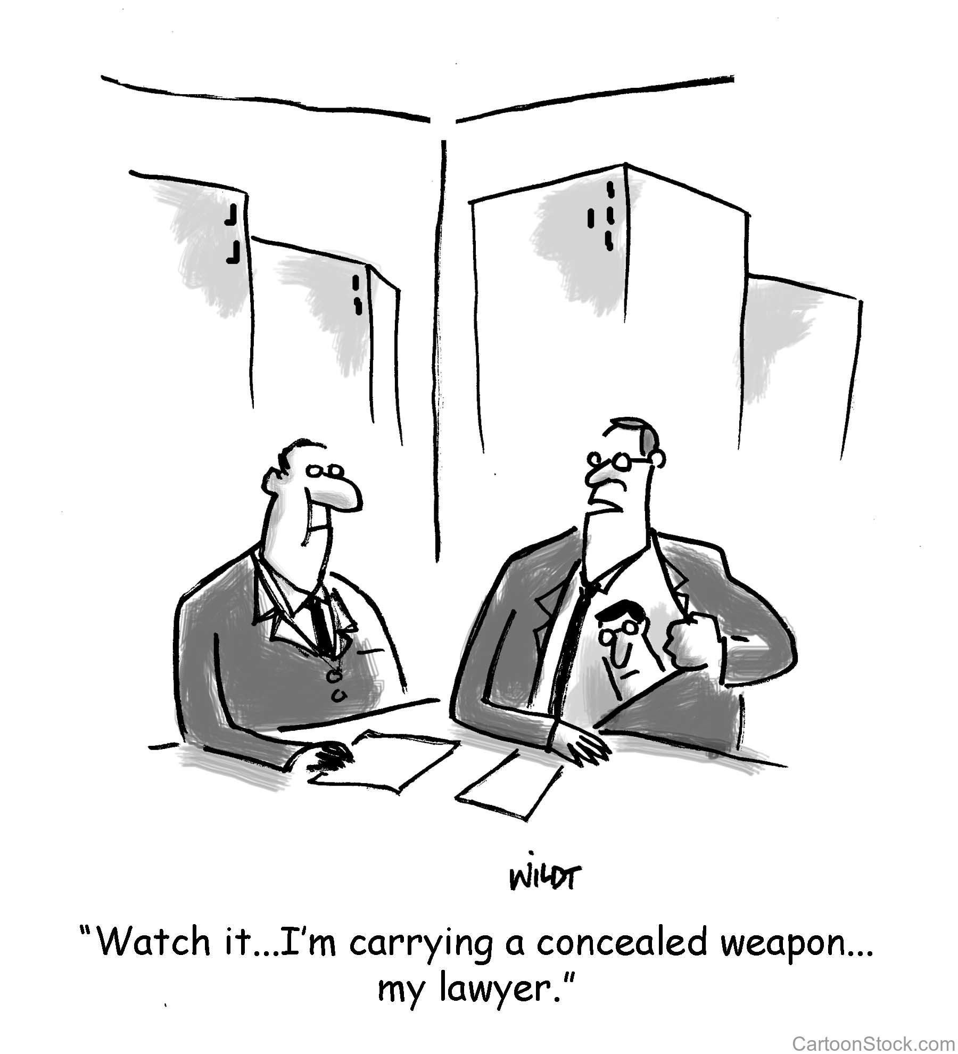
LEGISLATIVE UPDATES House bill 178 (under consideration)
Constitutional Carry, no permit or license required to conceal carry a deadly weapon in Ohio.
Can still take a class and get a permit to be eligible for reciprocity.
"Deadly weapon" means any instrument, device, or thing capable of inflicting death, and designed or specially adapted for use as a weapon, or possessed, carried, or used as a weapon.

Slide 13
QUESTIONS

